Slide 1



The simplest cartoon of ocean dispersal (that is not too simple)
James M. Pringle
University of New Hampshire

Slide 2
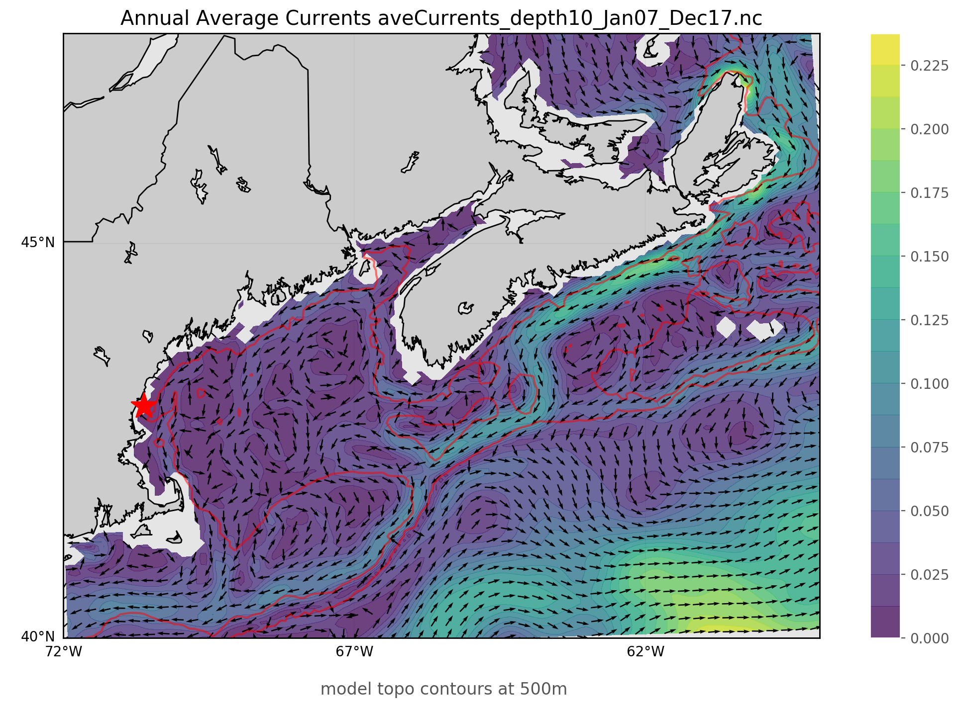
The ocean has mean currents
From 10 year average Mercator currents
Agree well with observations except where tides dominate
Units of m/s, or about 100km/day

Slide 3
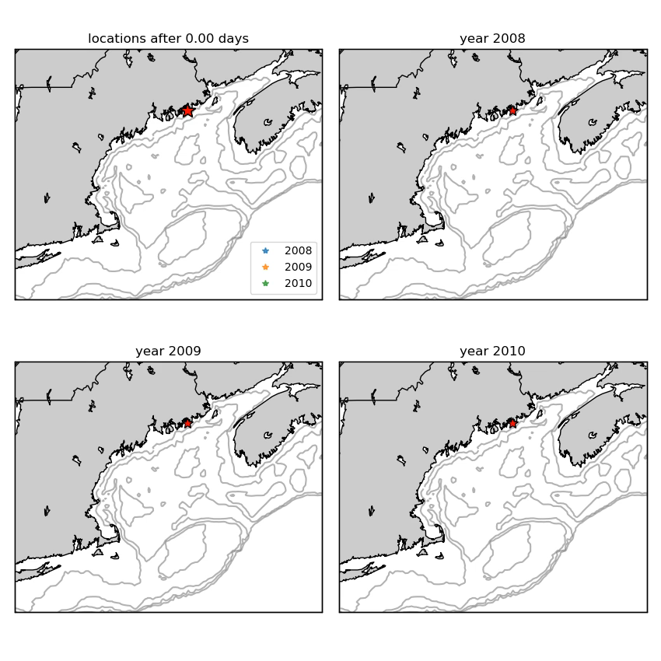
The fluctuations around the mean are large.
April of three years
From Mercator currents, surface particles.
Imagine a barnacle releasing larvae into the water every quarter day for a month

Slide 4
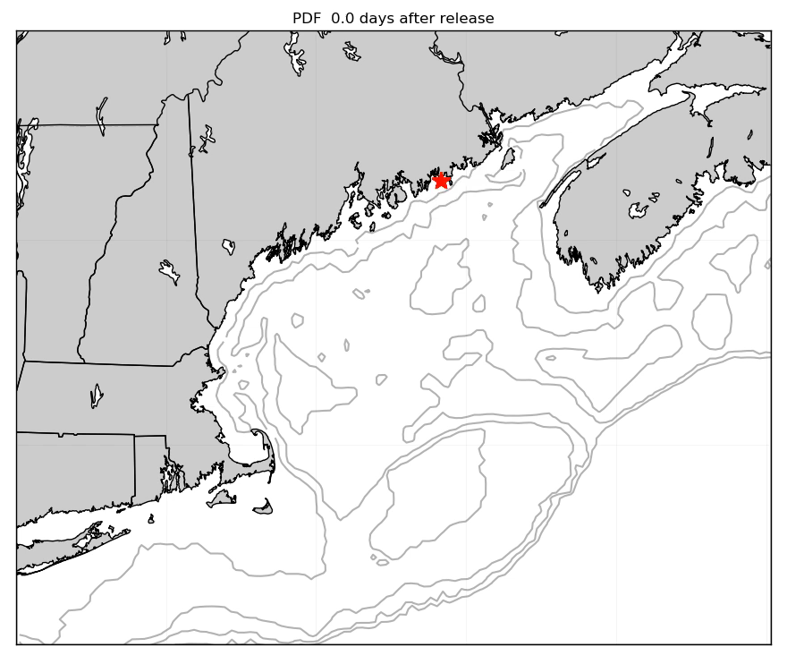
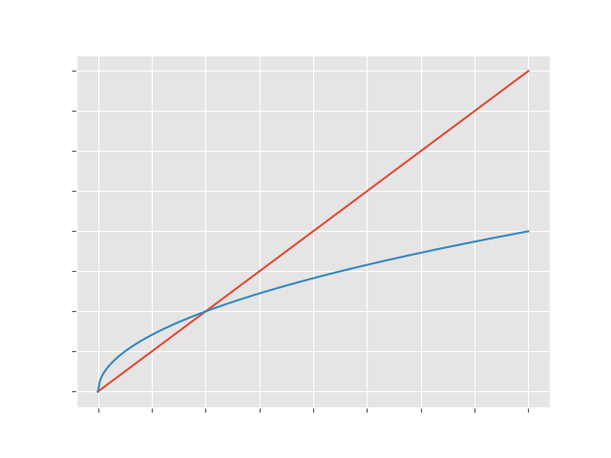
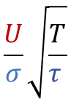
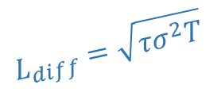
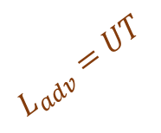
Which is larger, mean or fluctuations?
Depends on timescale
Mean L_{adv} as T
Stochastic L_{diff} as T^{1/2}
$$\frac{U}{σ}\sqrt{\frac{T}{τ }}$$
$$L_{adv}=UT$$
distance
$$L_{diff}=\sqrt{τσ^{2}T}$$
time

Slide 5
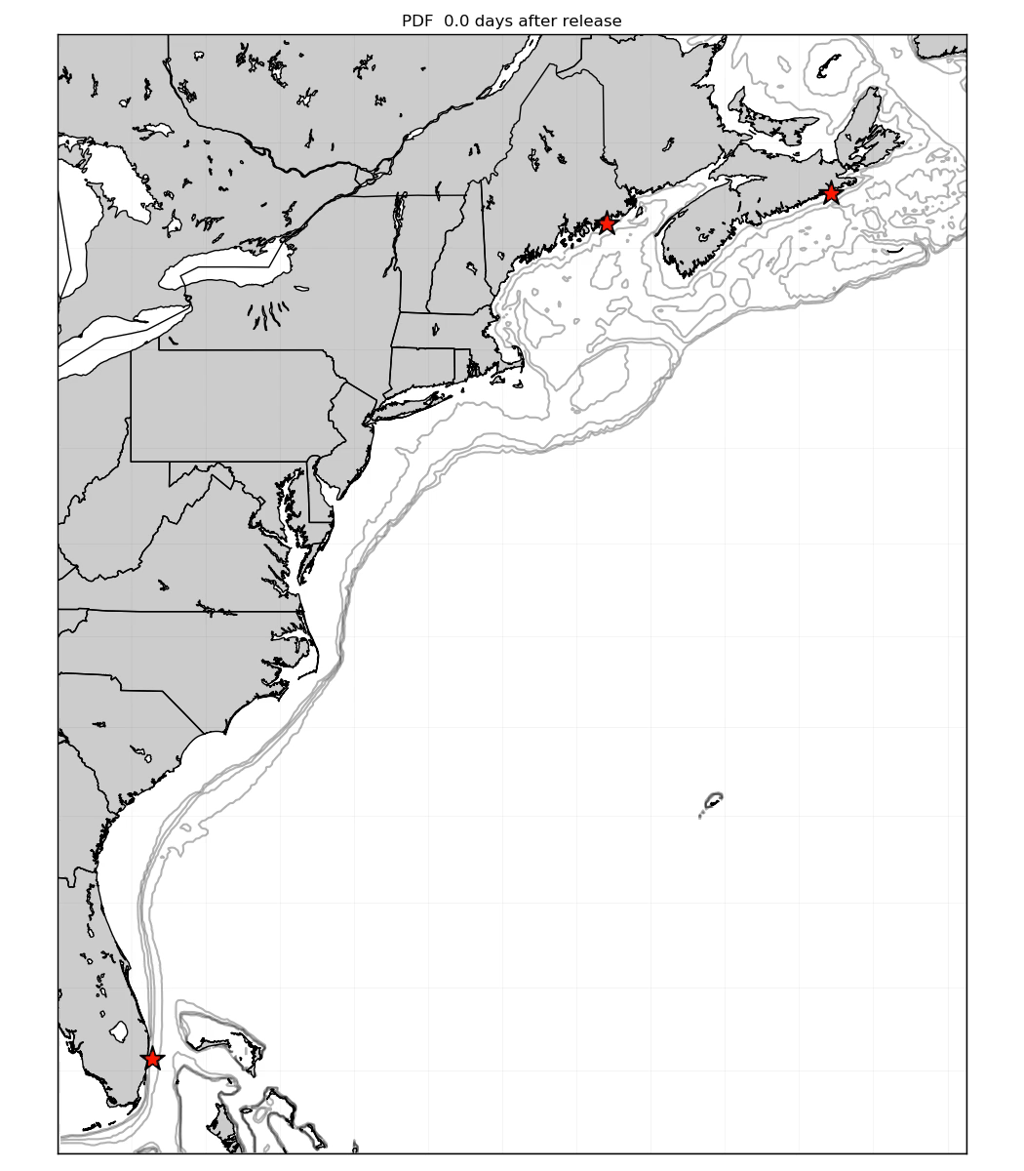
All these parameters depend on location
$$\frac{U}{σ}\sqrt{\frac{T}{τ }}$$
$$L_{adv}=UT$$
distance
$$L_{diff}=\sqrt{τσ^{2}T}$$
time

Slide 6
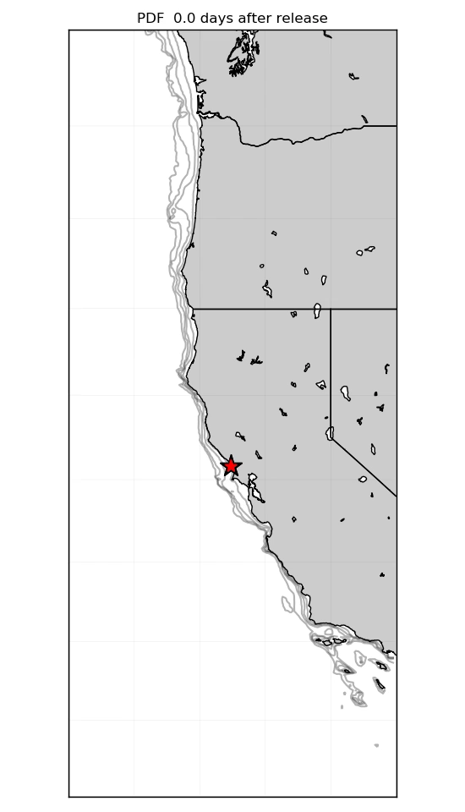
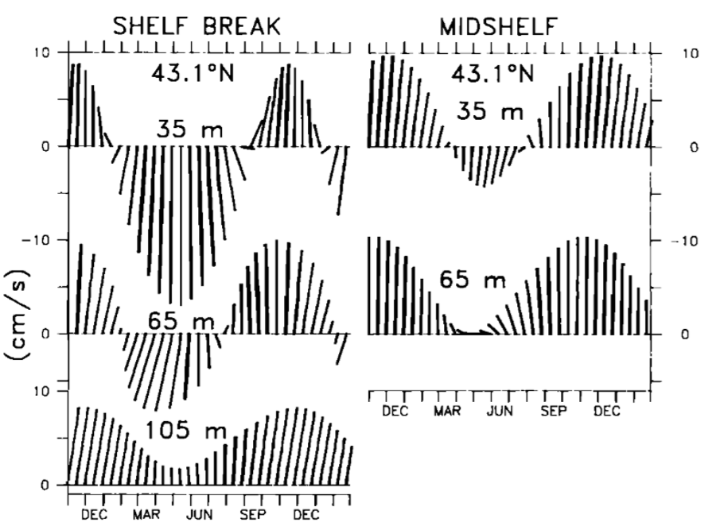
All of the parameters depend on life history!
Depth of larvae
Season of spawning
Strub et al. 1987

Slide 7
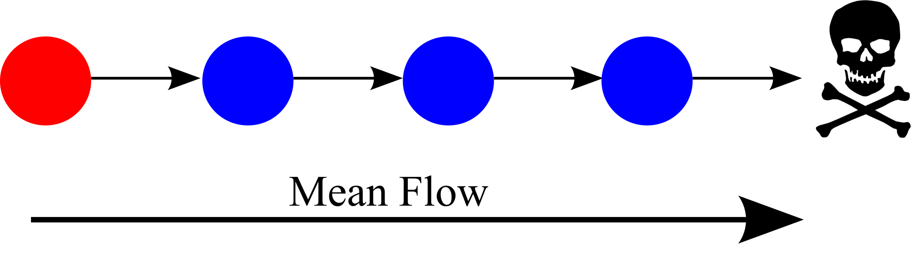
Why all the fuss about variability in dispersal?

Slide 8
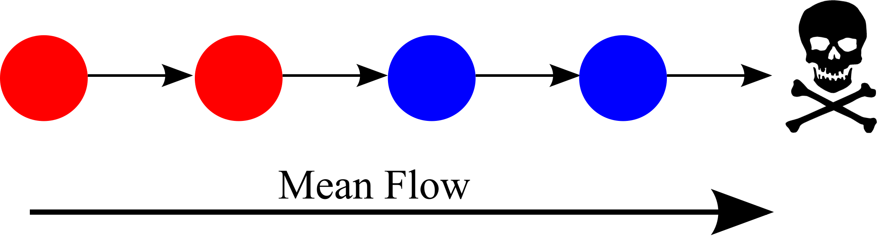
Why all the fuss about variability in dispersal?

Slide 9
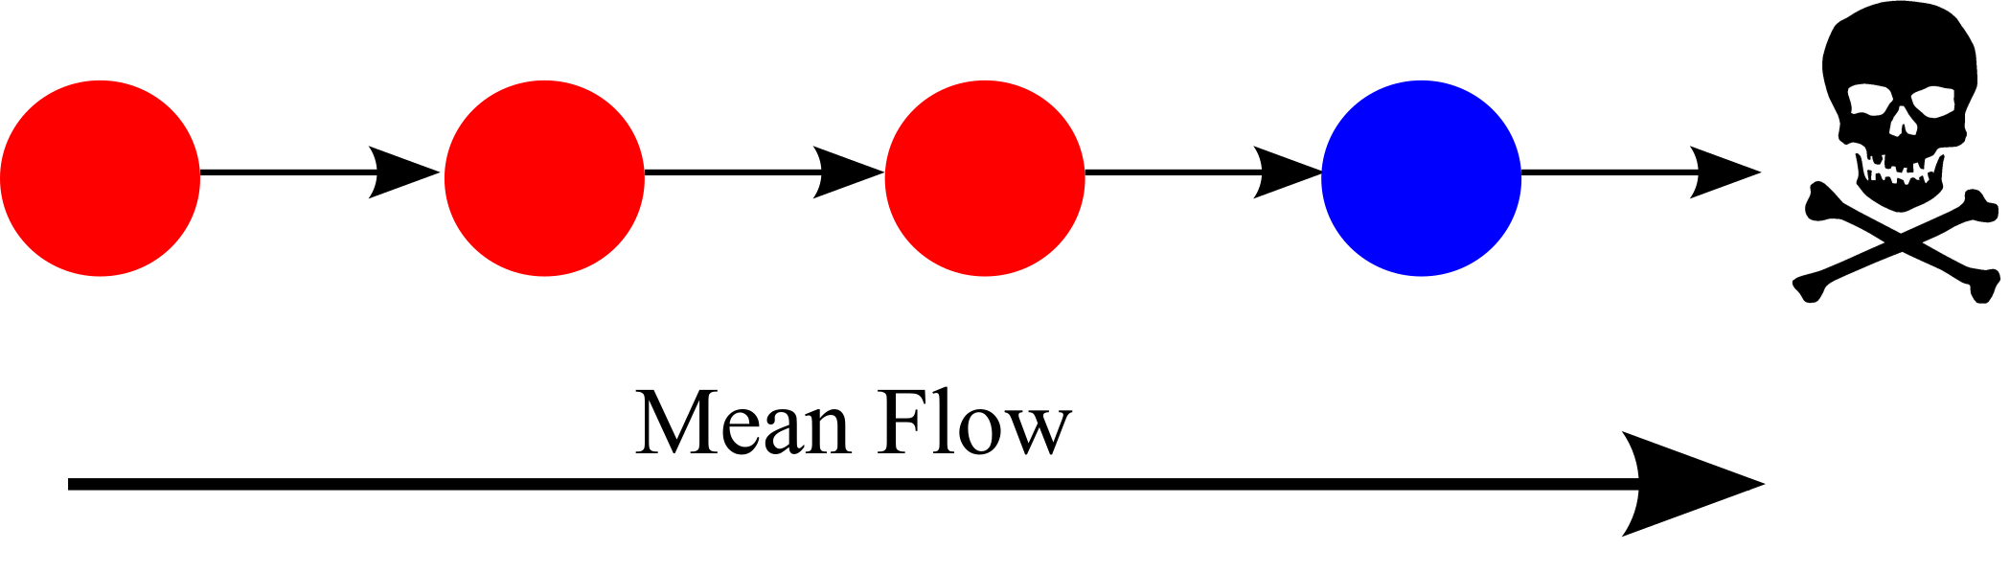
Why all the fuss about variability in dispersal?

Slide 10
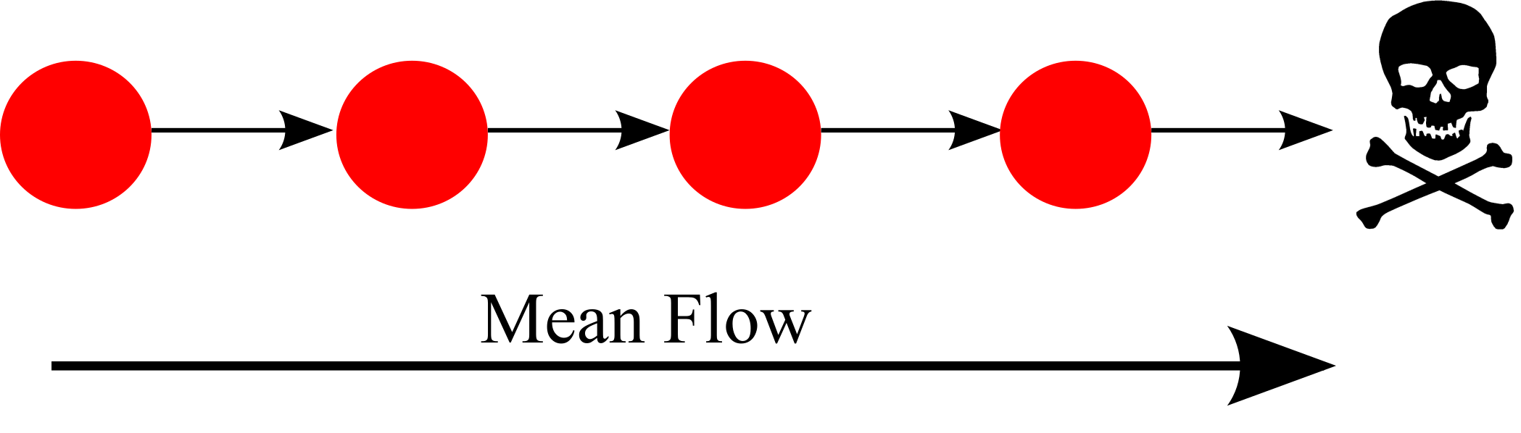
Why all the fuss about variability in dispersal?

Slide 11
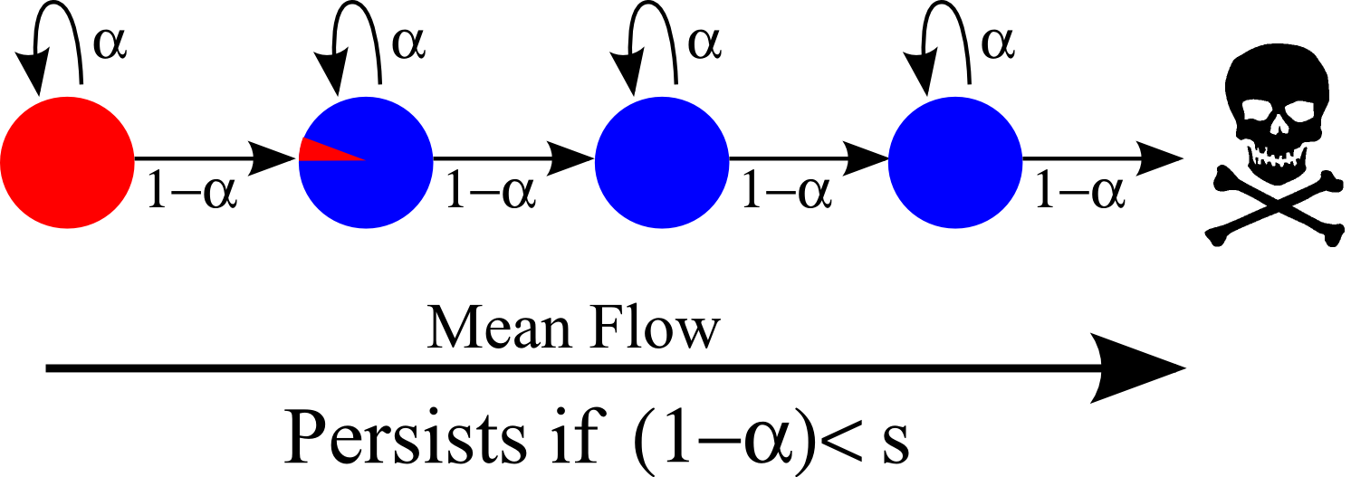
So now add some variability in dispersal

Slide 12
Generation 2

Slide 13
Generation 3

Slide 14
What if blue allele has a fitness advantage?
This is an old idea in population genetics of meta-populations, e.g. Nagylaki
Where are the two length-scales hidden? Pringle & Wares 200?

Slide 15
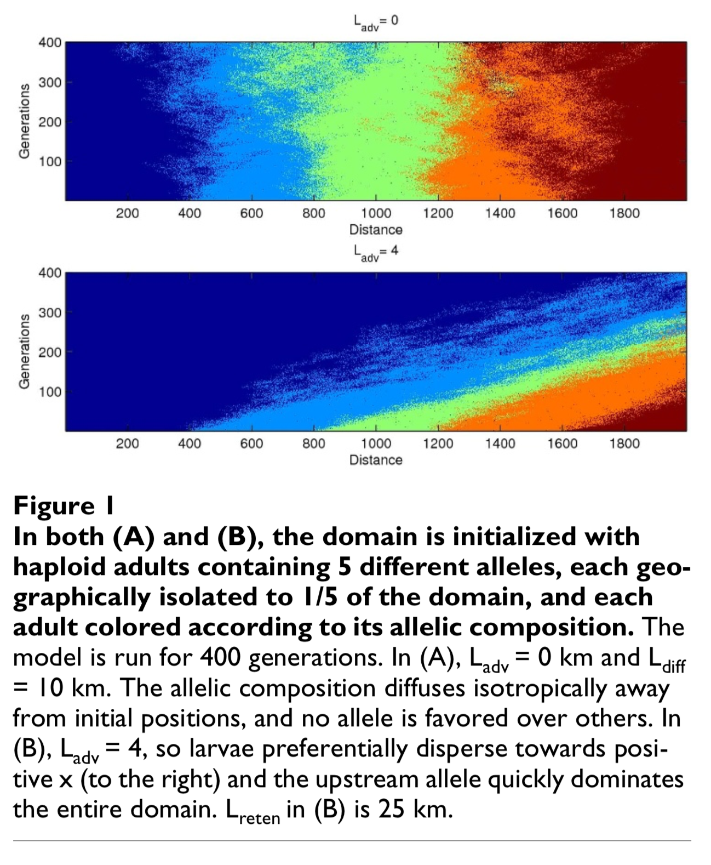
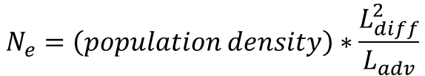
We need simple models which include variability!
Example from Wares & Pringle 2008
$$N_{e}=\left(population density\right)∗\frac{L_{diff}^{2}}{L_{adv}}$$

Slide 16
Conclusion (part 1)
To understand local adaptation and genetics in ocean, we need to think about the two length scales of dispersal
The mean downstream transport
The variability in downstream transport
Any analysis that is focused on a single estimate of dispersal is likely wrong

Slide 17
RCN Conclusions
Much to be done
Listen to the ocean
Simple, but not too simple
Don’t you be the bad physicist
Two length scales!
And we can estimate currents globally! No excuse for ignoring!

Slide 18
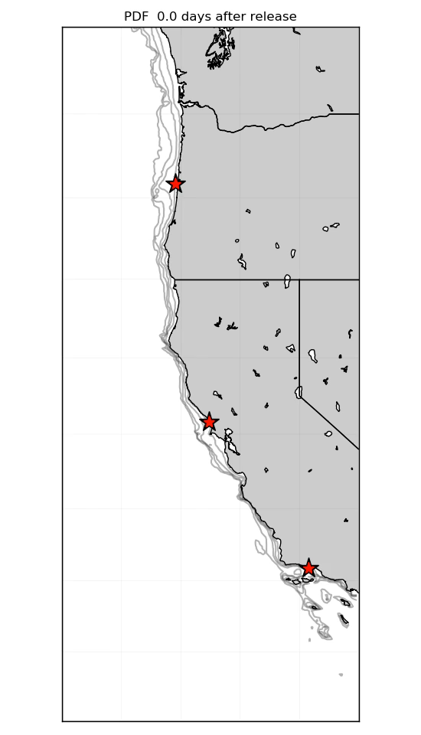

Thanks!

Slide 19
Conclusion
To understand local adaptation and genetics in ocean, we need to think about the two length scales of dispersal
The mean downstream transport
The variability in downstream transport
Any analysis that is focused on a single estimate of dispersal is likely wrong

Slide 20
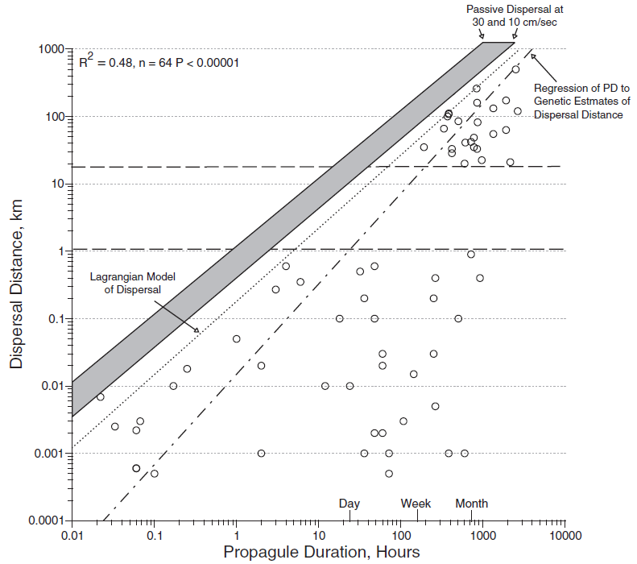
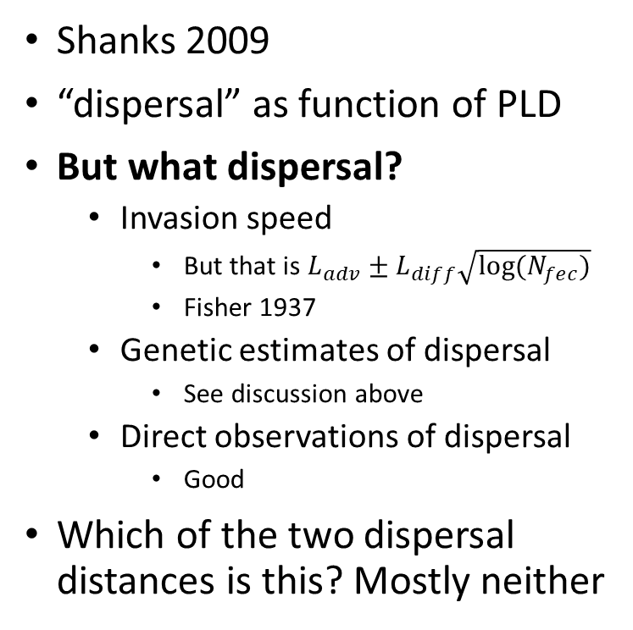
Shanks example.
Shanks 2009
“dispersal” as function of PLD
But what dispersal?
Invasion speed
But that is $L_{adv}±L_{diff}\sqrt{log⁡(N_{fec})}$
Fisher 1937
Genetic estimates of dispersal
See discussion above
Direct observations of dispersal
Good
Which of the two dispersal distances is this? Mostly neither

Slide 21
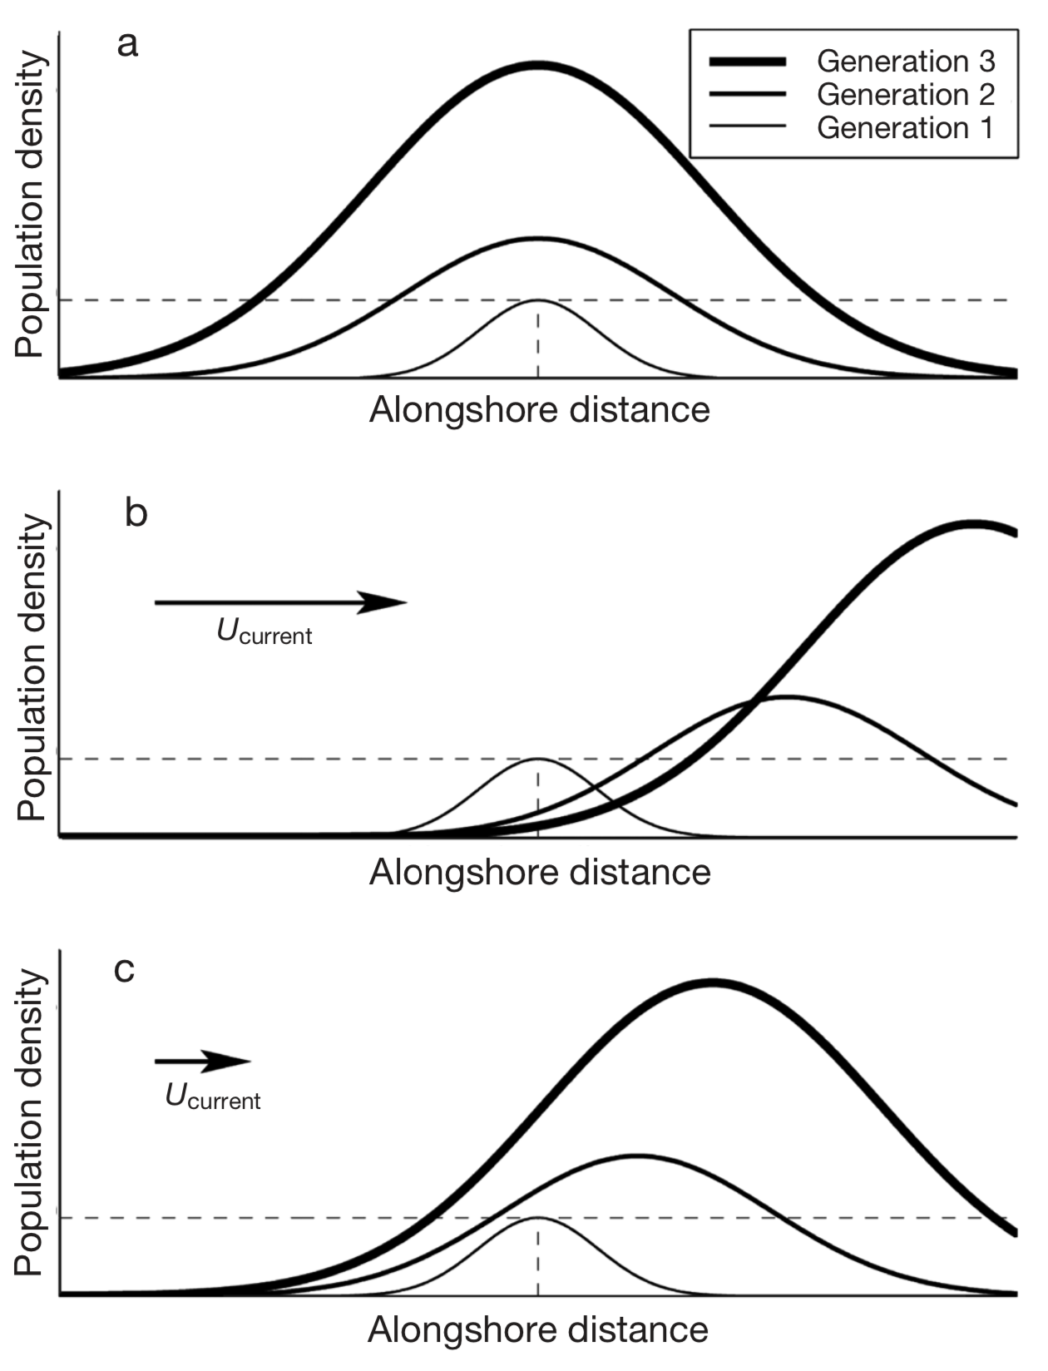
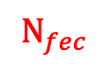
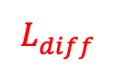
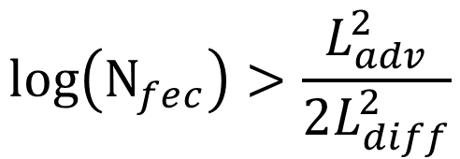
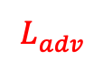
So how is this relevant to this RCN?
$$L_{diff}^{}$$
$$N_{fec}$$
Population level*
Two lengths scales!
$$\log\left(N_{fec}\right)>\frac{L_{adv}^{2}}{2L_{diff}^{2}}$$
$$L_{adv}^{}$$
*For non-Gaussian kernels, see Pringle et al. 2009

Slide 22
What if no competitive difference?

Slide 23
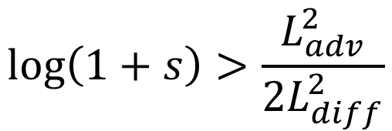
Continously… (realistically…)
$$L_{diff}^{}$$
(1+s)
Allele level*
Two lengths scales!
$$\log\left(1+s\right)>\frac{L_{adv}^{2}}{2L_{diff}^{2}}$$
$$L_{adv}^{}$$
*Pringle and Wares, 2007

Slide 24
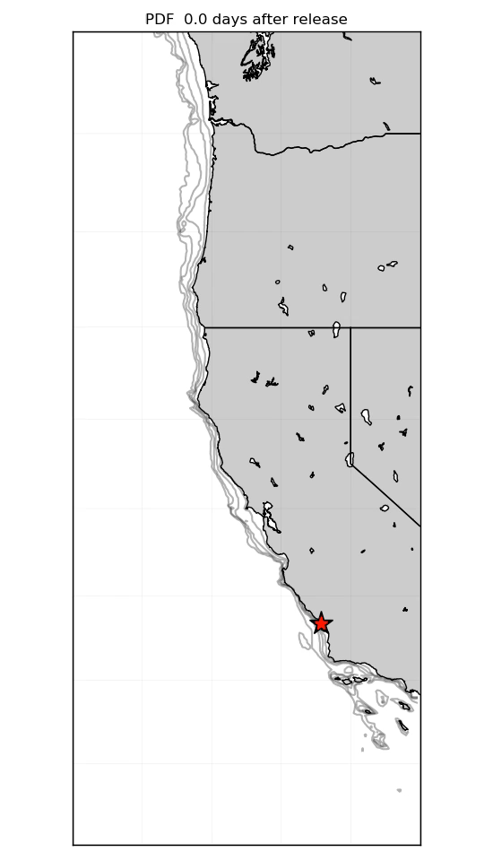
May release

Slide 25
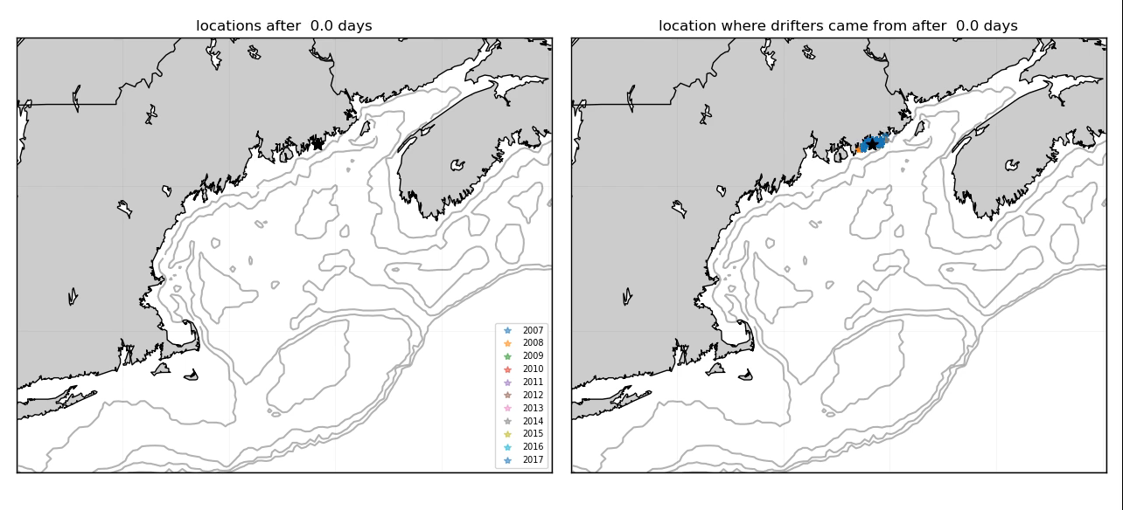

Slide 26
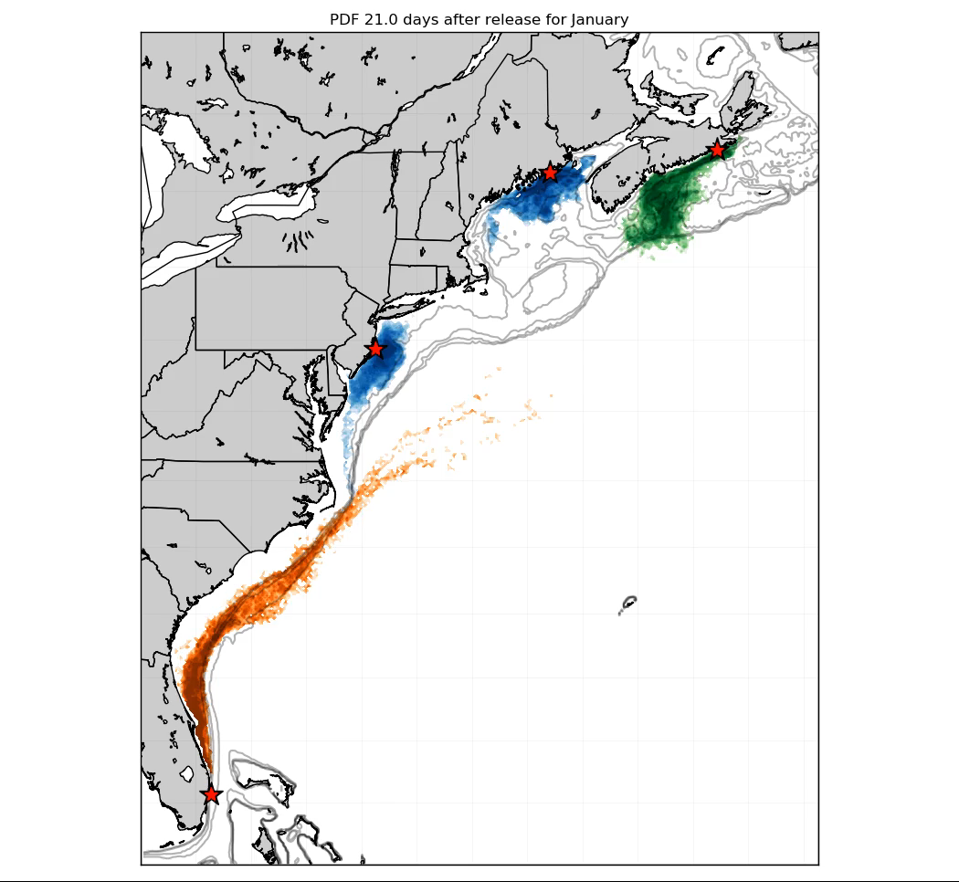
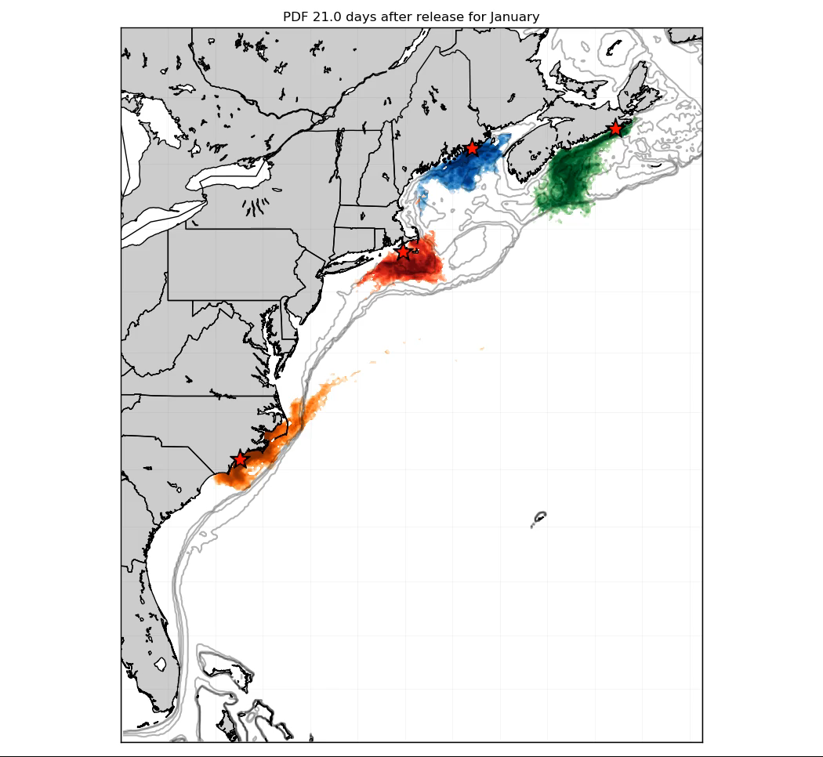

Slide 27
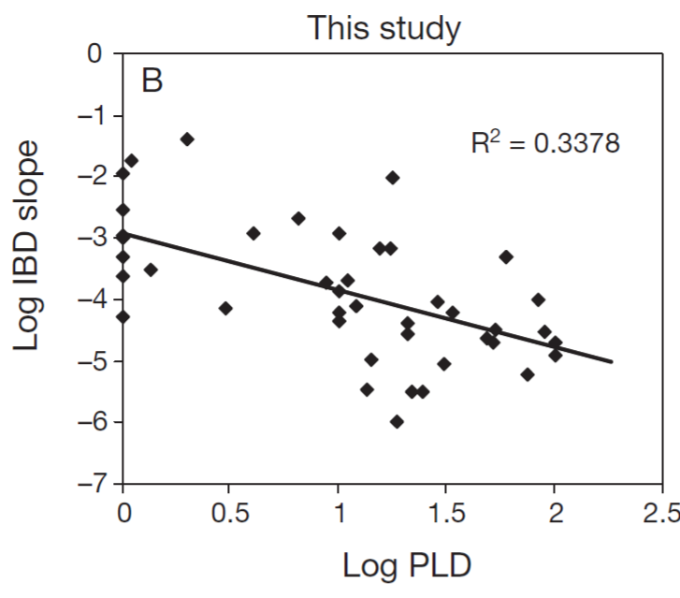
Or else… Selkoe and Toonen (2011)
What does this mean?
PLD
IBD slope
Does this mean that planktonic dispersal is not relevant?

Slide 28
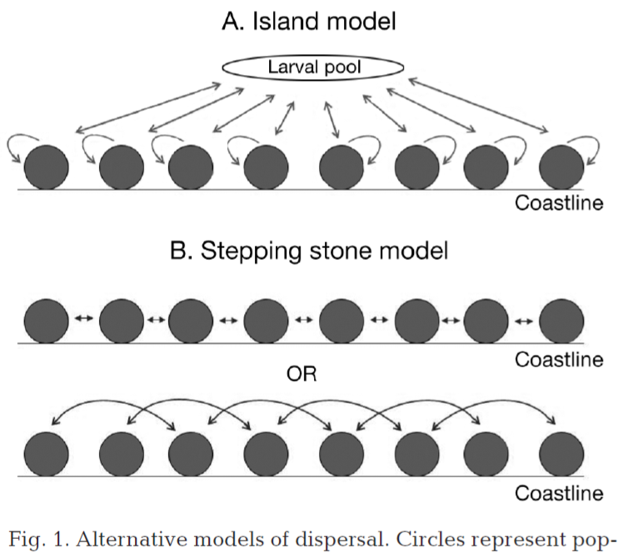
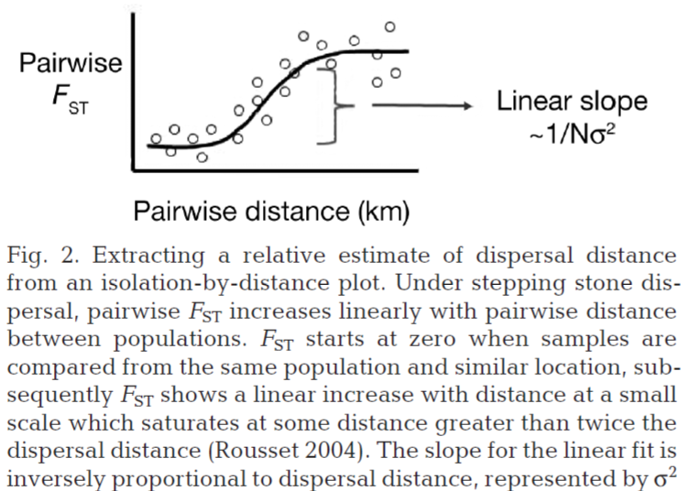
What’s wrong with that?
And I am not picking on them, this is as good as it gets

Slide 29
So what do they examine?
What does this mean?
PLD
IBD slope
Do we expect, for observations in different places, that doubling PLD doubles the distance the larvae move?
Do we expect, if the average distance a larvae move is doubled, that it means anything to IBD?

